Slide 1
IBM Data Science Presentation

Slide 2
Data
District names & coordinates
Foursquare venue data

Slide 3
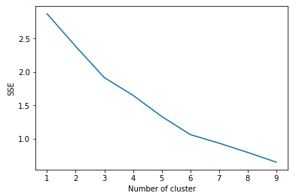
Clustering
Determine optimal N Clusters:
N=6

Slide 4
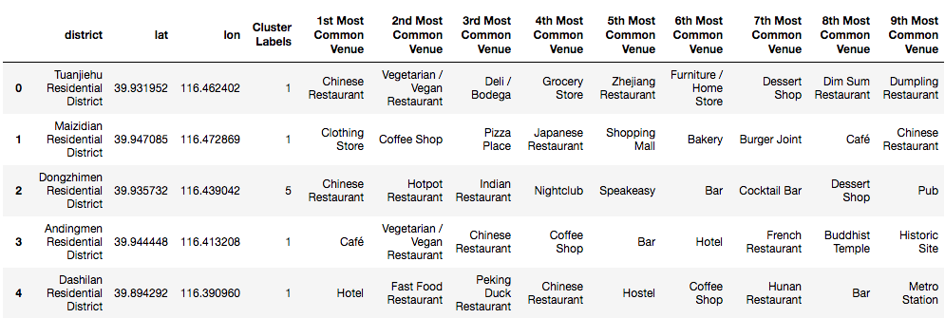
Clustering
Based on Most Common Venues

Slide 5
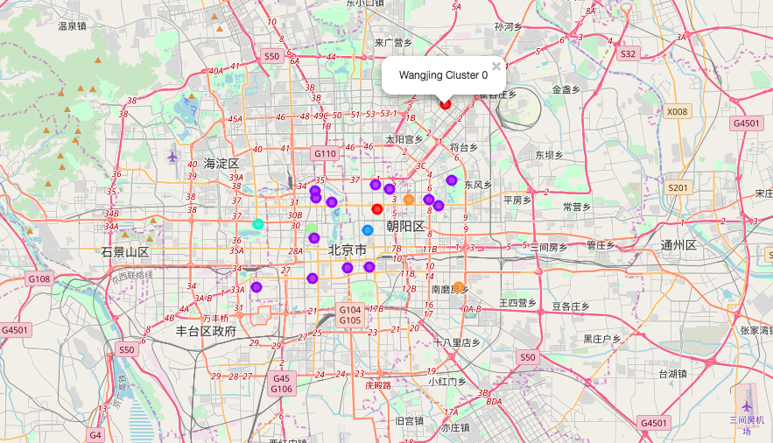
Result

